Slide 1
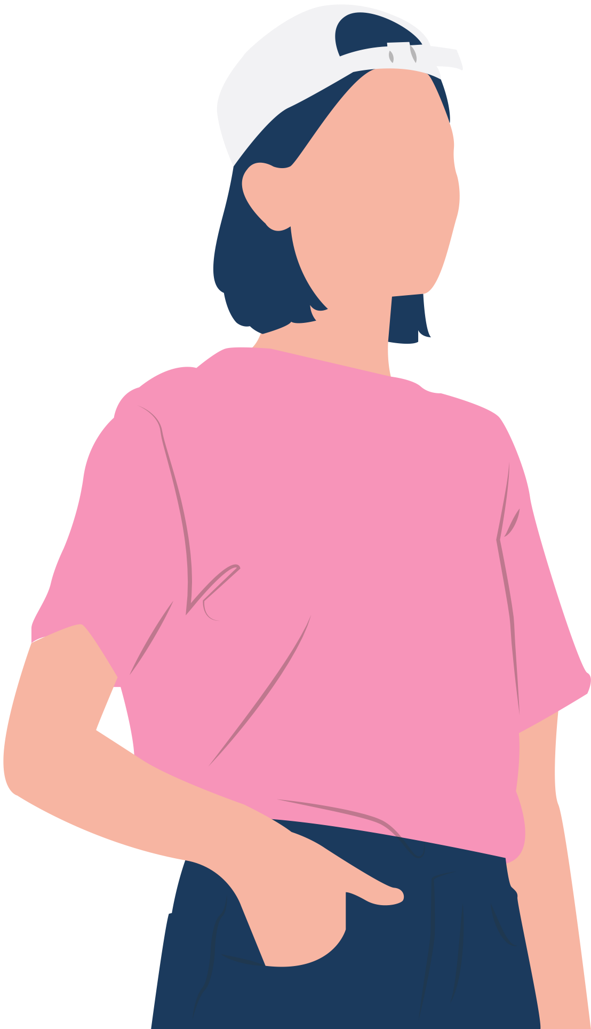
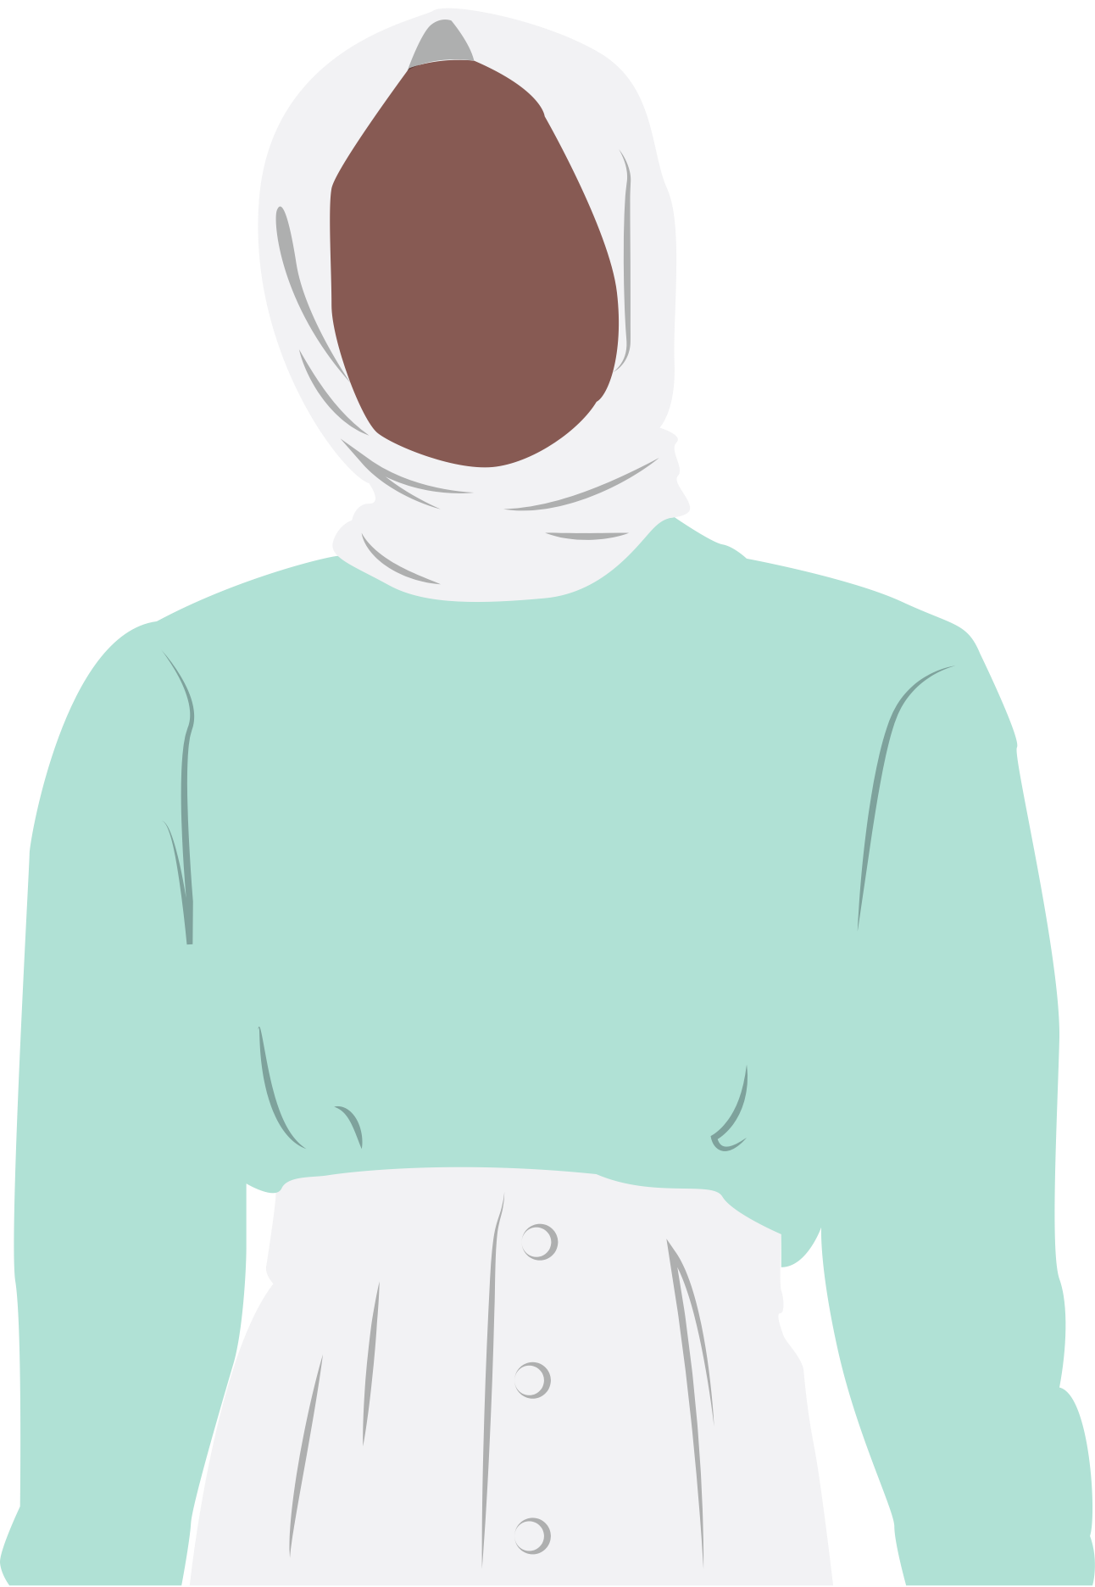

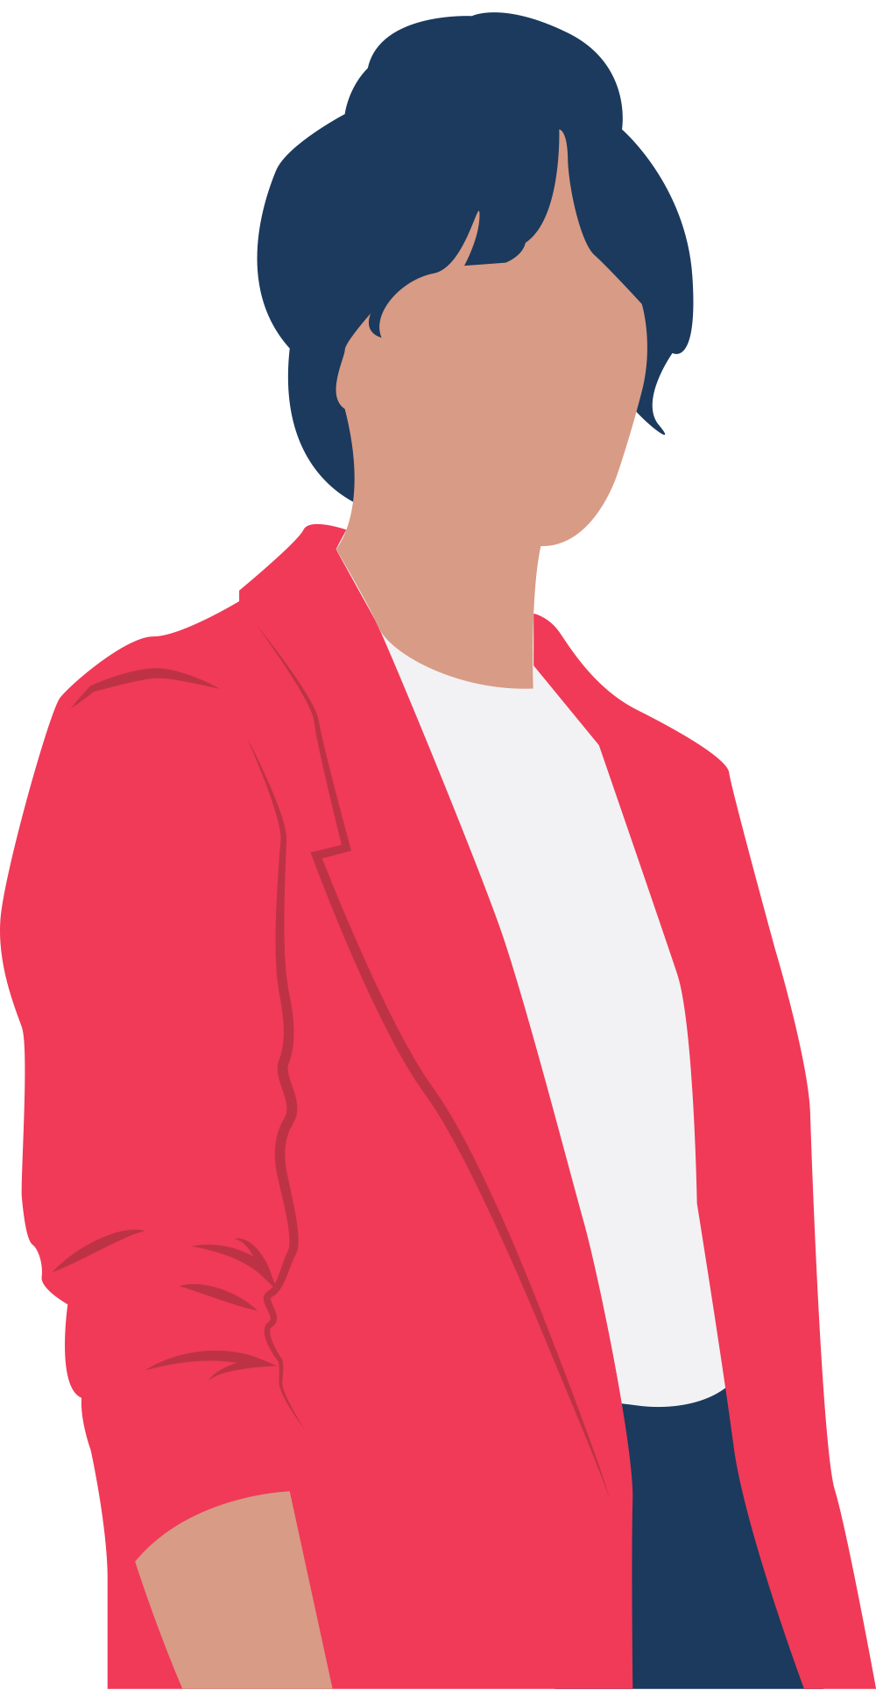

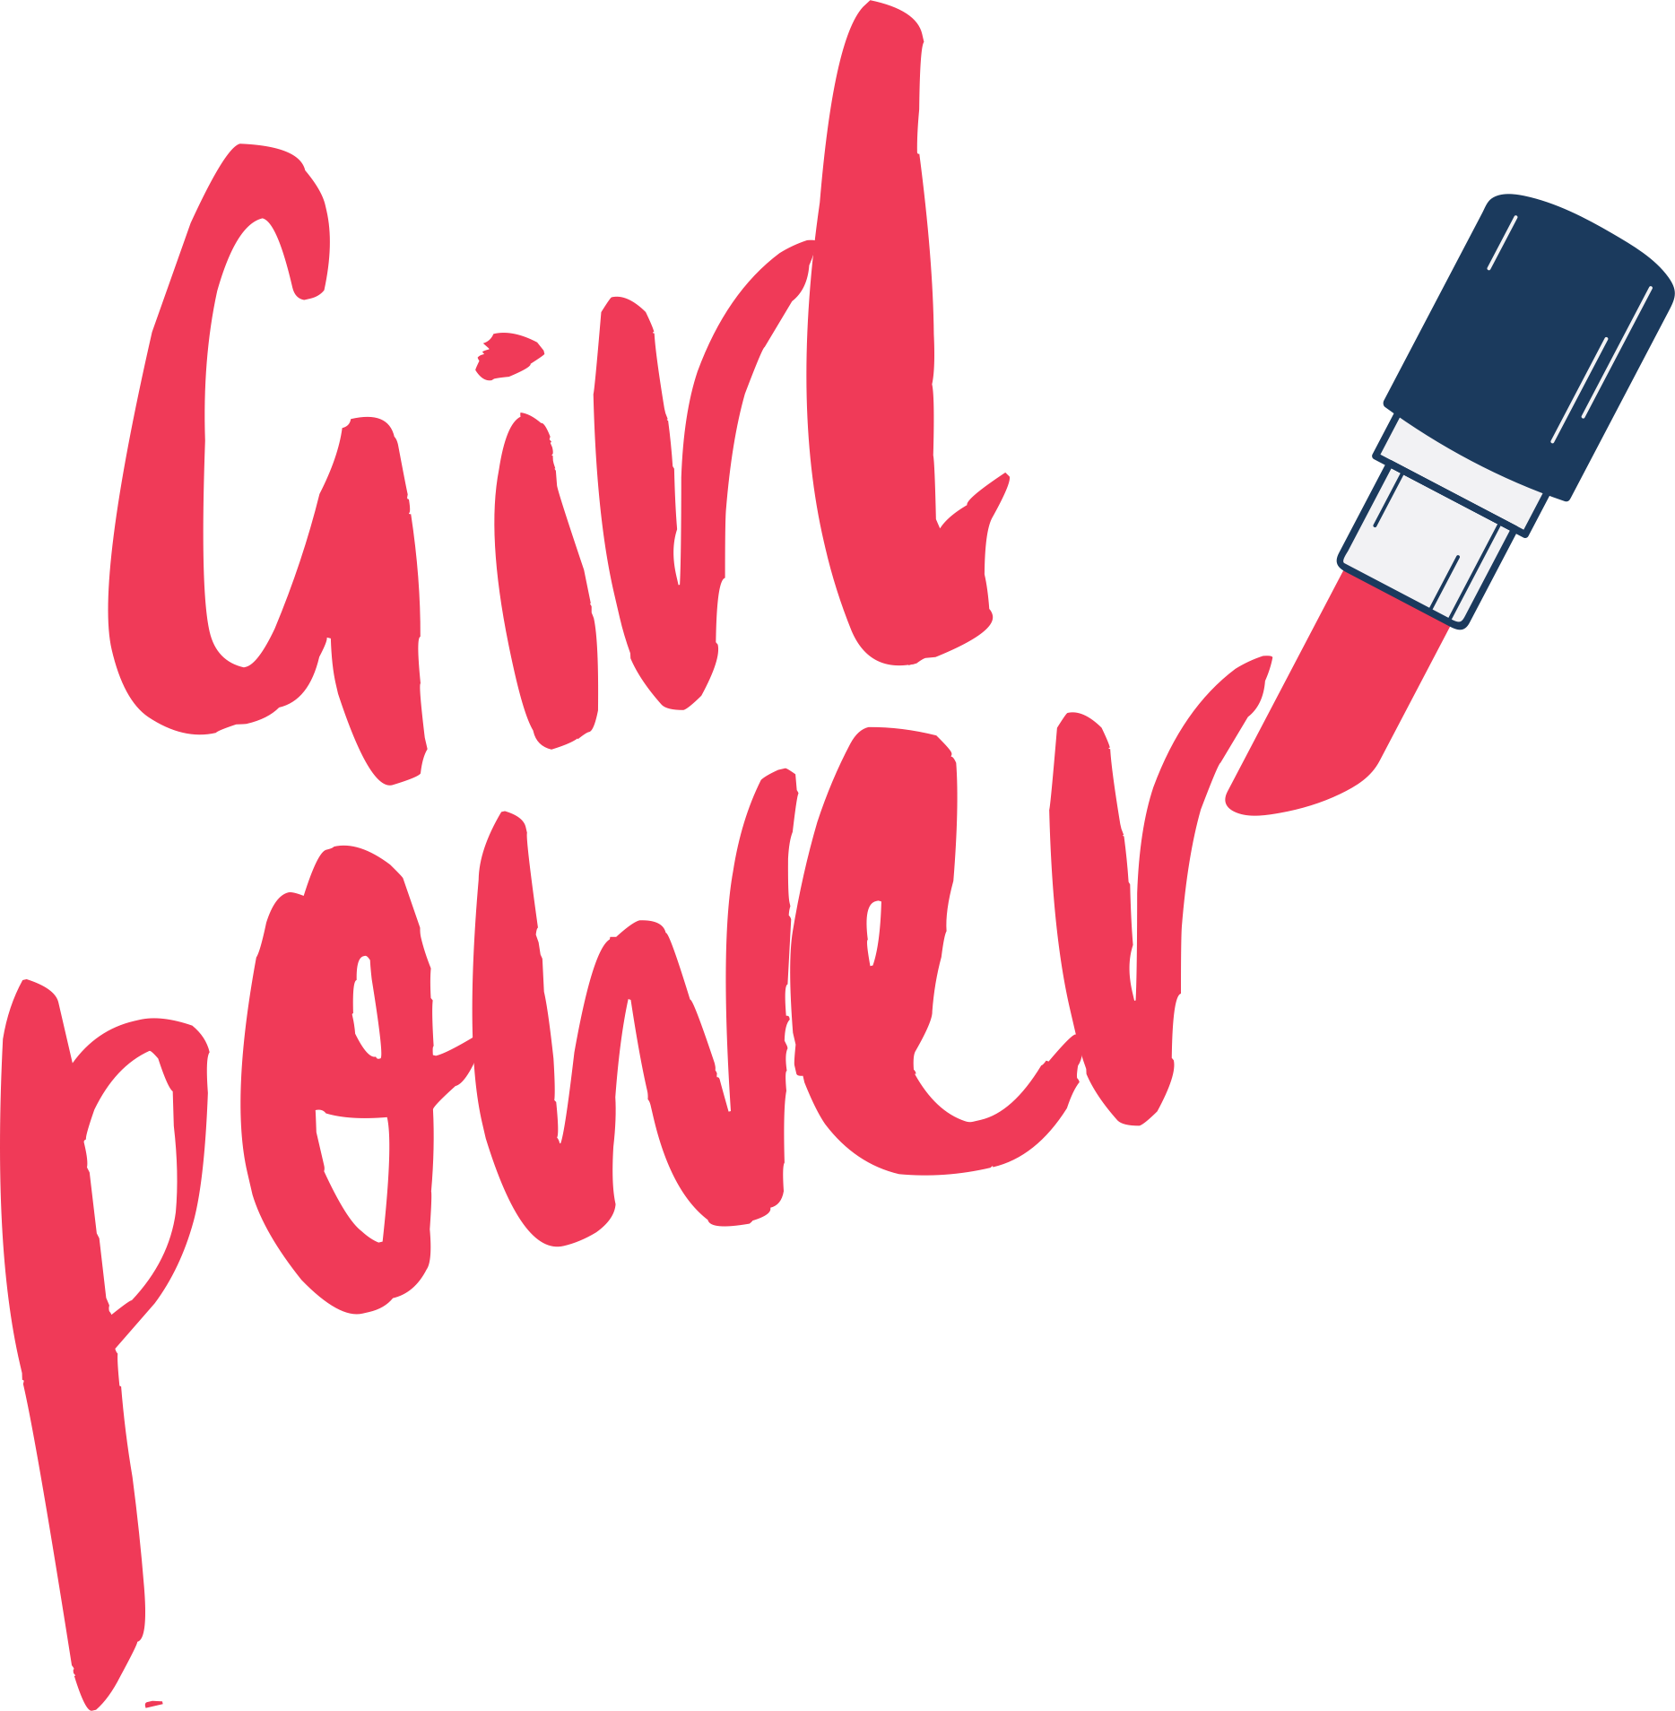
Your Voice Matters:
Women In Public Speaking
Irine Kokilashvili for WTM Berlin
12 MARCH, 2025

Slide 2



WHO AM I?
DevOps Engineer, AWS Community Builder, Rust enthusiast, Frequent Speaker, Podcast Host, and most importantly Advocate for Women in Tech
Notes:
Hi everyone, my name is Irine Kokilashvili. I’m a DevOps Engineer, a Rust enthusiast, and an international tech speaker. I also host of the QnA with Friends podcast, where I talk to industry professionals about their journeys in tech.
But today, I’m not here to talk about technology. I’m here to talk about something just as important: representation. Specifically, the representation of women in public speaking and why our voices matter.

Slide 3

MY JOURNEY AS A SPEAKER
REALIZING THE GAP:
Noticed the lack of female speakers and attendees
SEEKING COMMUNITY: Attended conferences to learn, connect and find other women in IT
Notes:
When I started my career in tech, I attended a lot of conferences. At first, my goal was simple—I wanted to make friends, learn from experts, and hopefully meet other girls in IT. I was excited to be in those spaces, surrounded by people who were passionate about technology. I would sit in the audience, take notes, and absorb everything I could. But the more events I attended, the more I started to notice something. I kept looking for speakers who looked like me, who shared my experiences, who faced the same challenges I did. I wanted to hear from women who had navigated the same industry struggles, who could inspire me and make me feel like I belonged. But honestly? I rarely found them.
At first, I thought maybe I was just attending the wrong events. But as time went on, it became impossible to ignore—there simply weren’t enough women on stage and in attendance. The tech industry was already male-dominated, but seeing that reflected so clearly in the speaker lineups and event attendance made it even more discouraging.

Slide 4
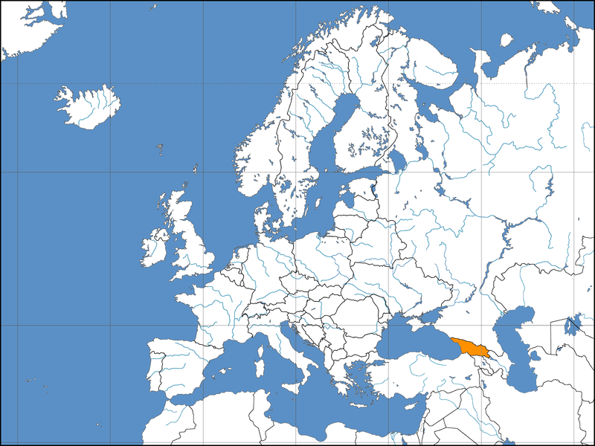
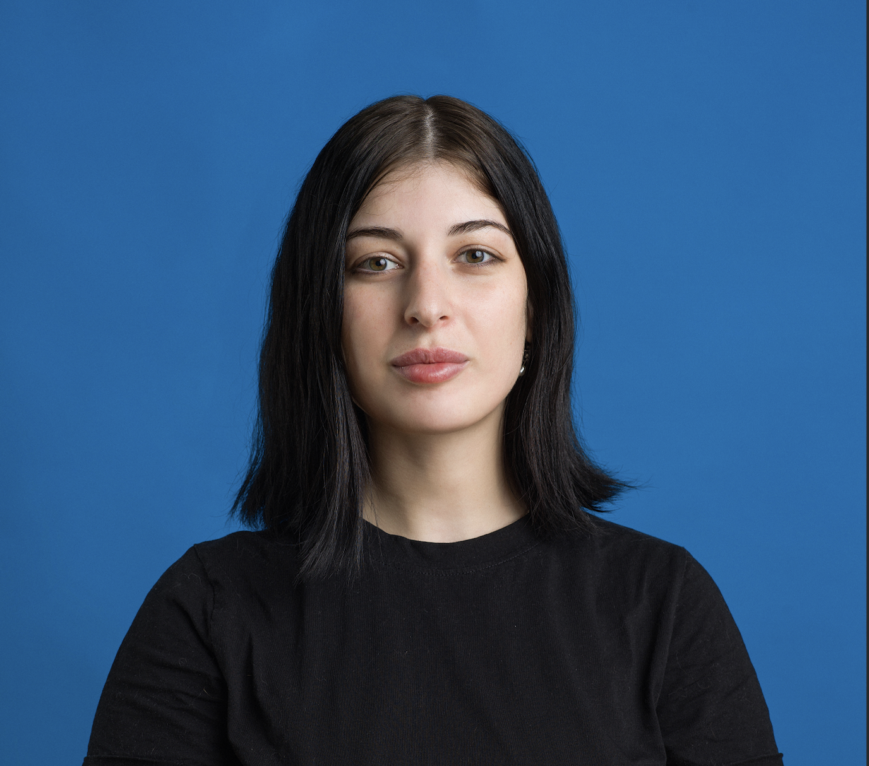

Notes:
To really understand why this matters to me, let me take you back to where I’m from—Tbilisi, Georgia.
Georgia is a small country with a pretty traditional mindset, and growing up, tech wasn’t a common career path, especially for women. That became even more obvious when I went to university—I was one of only two girls in my class.

Slide 5

GROWING UP
IN GEORGIA
SHE DIDN’T LEAVE BECAUSE SHE WASN’T CAPABLE
SHE LEFT BECAUSE SOCIETY EXPECTER HER TO
Notes:
My only female classmate was brilliant, hardworking, and full of potential. But society had other plans for her. She got married young, had a child, and had to drop out. After that, I was the only girl left.
It was a lonely experience. I wasn’t just missing other women—I was missing that sense of connection, of belonging. It wasn’t just about the numbers; it was about knowing that someone else understood what it was like to be me..
it was a stark reminder of the reality many women in Georgia face. I wasn’t just the only girl left—I was watching firsthand how society shaped our futures in ways we didn’t always get to choose. And beyond the isolation, I felt a deep sense of unfairness. She deserved to be there just as much as anyone else
"She didn’t leave because she wasn’t capable—she left because society expected her to."

Slide 6
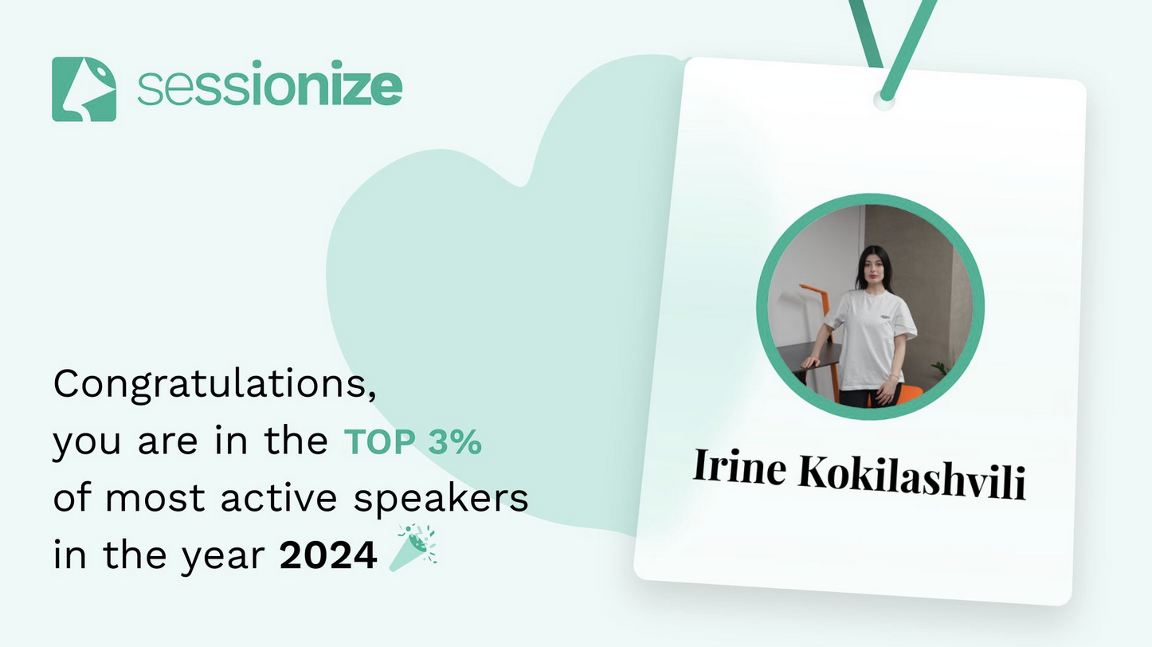
REALITY OF WOMEN IN TECH
BIAS ISN’T ALWAYS HIDDEN.
SOMETIMES IT IS RIGHT IN FRONT OF YOUR FACE.
Notes:
My speaker journey at the end of 2023 and, in the beginning of 2025, I received an award for top active 3% of speakers.
I was so excited for this achievement! The platform also showed the data of all speakers that received the same achievement and it was apparent that there were far more men than women.
I was wondering what discouraged women to speak? But I didn’t have to search so far because I myself had a bad experience couple times one of the experiences:
I remember one of my first events as a speaker. A group of speakers was standing together, and as I overheard their conversation about Linux, I decided to join in. When I approached the circle, one of the men looked at me and asked why I had walked up to them. I explained that I had overheard the discussion and was curious. He smirked and asked if I even knew what Linux was, implying that I had no clue and should step away. At first, I couldn't quite read the situation. I simply explained my profession and decided to stay. At some point, the conversation shifted to hiring processes. He mentioned being responsible for hiring in his IT department, he proceeded to look directly at me and said he never hired women because according to him "they are dumb and stupid." Jokes on him, I know how far I've come and I never let his words affect me, but the reality is that other girls might react differently. It's a constant reminder of the challenges women in tech still face.

Slide 7
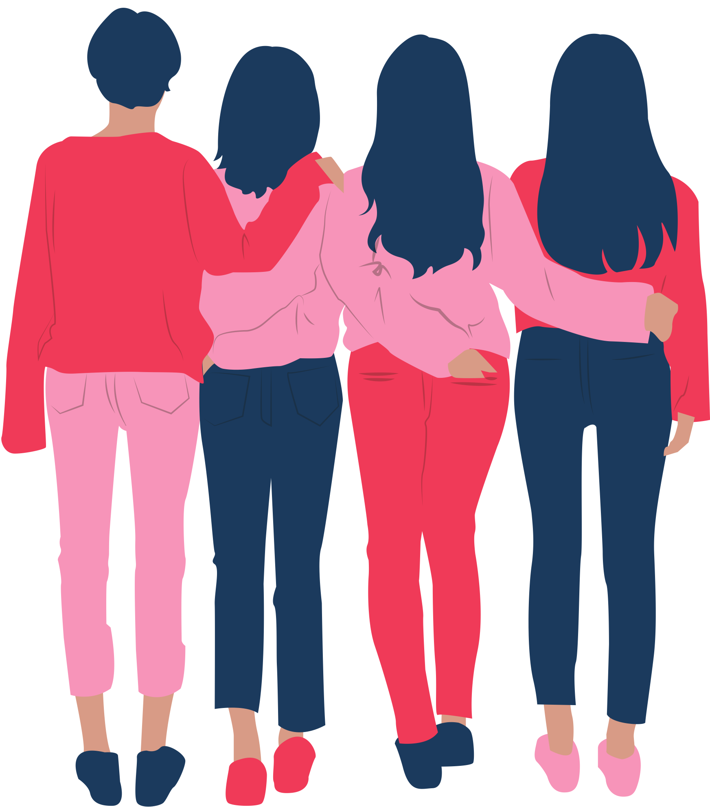
THE GLOBAL SURBEY FIND THAT 87 PERCENT BELIEVE WOMEN ARE UNDERREPRESENTED IN THE IT SECTOR
https://www.isaca.org/about-us/newsroom/press-releases/2024/isaca-research-only-41-percent-of-businesses-have-programs-in-place-to-hire-more-women-in-tech
WOMEN MAKE UP TO 33% OF THE TECH-RELAETD WORKFORCE
https://ecwt.eu/news/gender-diversity-in-tech-2024
50% OF WOMEN IN TECH LEAVE THEIR JOB BEFORE THE AGE OF 35
https://ecwt.eu/news/gender-diversity-in-tech-2024
MORE THAN 50% OF WOMEN IN TECH REPORT GENDER INEQUALITY, DISCRIMINATION, OR SEXUAL HARASSMENT IN ENVIRONMENTS DOMINATED BY MEN.
https://explodingtopics.com/blog/women-in-tech?
NEW DATA SHOWS ONLY 25% OF SPEAKERS AT TECH EVENTS ARE WOMEN
https://startupsventurecapital.com/new-data-shows-only-25-of-speakers-at-tech-events-are-women-bd0578f28037
Notes:
Lets look at some numbers that matter for women in tech.

Slide 8



EMPOWER ONE.
EMPOWER ALL.
Notes:
Fastforward to attending conferences and events, I started wondering—why are so many women missing from spaces such as IT conferences and events? Why don’t we see more female speakers? And more importantly, how do we change that?
I decided I wasn’t going to wait for change.
I wanted to be the representation I never had. I wanted to be the speaker I was looking for and I wanted to become a figure other girls could look up to.
"If I could inspire even one girl, she could spark a chain of inspiration for others."

Slide 9
I BELIEVE THAT WOMEN HAVE MANY VALUABLE INSIGHTS. WHY AREN’T WE HEARING THEIR VOICE ON STAGE?
Notes:
What do you think? Why aren’t we hearing more women on the stage?

Slide 10
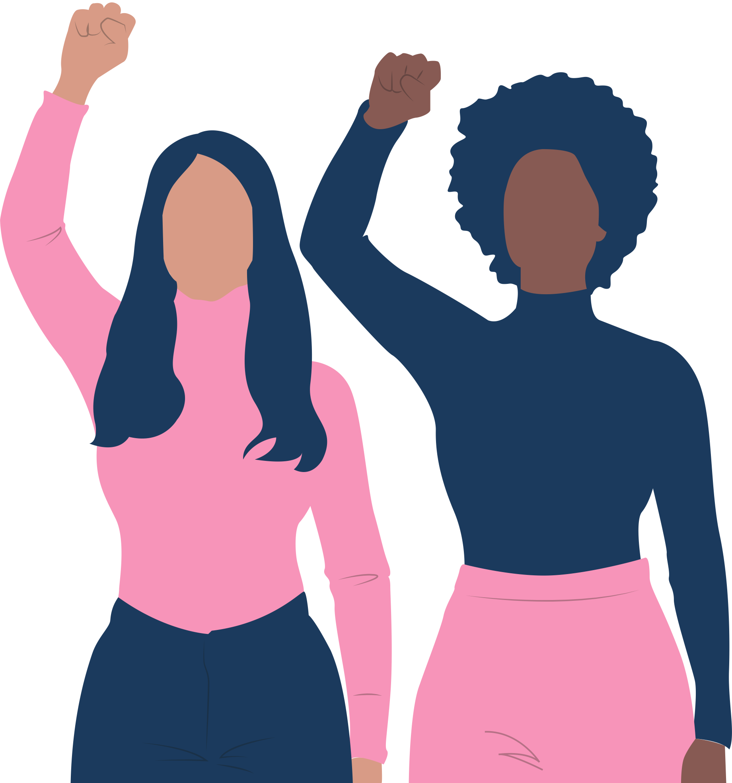
GETTING YOUR VOICE HEARD IS IMPORTANT
IT’S TIME TO TAKE UP SPACE
Women are often conditioned to stay in the background, but it's time to take up space. Your voice matters, and conferences offer a platform to share your insights and make a lasting impact.
BREAK THE GENDER ROLES
Speaking at conferences helps break gender norms, showing that women belong in male-dominated industries and highlighting the value of diverse perspectives for innovation.
CREATE A SUPPORTIVE COMMUNITY
INSPIRE THE NEXT GENERATION
Women speaking at conferences inspire others to follow their lead, challenge the myth that leadership and technical roles are for men, and serve as role models for girls and women who may feel they don’t belong or aren’t capable.
Speaking at conferences helps break gender norms, showing that women belong in male-dominated industries and highlighting the value of diverse perspectives for innovation.
Notes:
1. Breaking the Gender Norms
For many years, certain industries and technical spaces have been dominated by men, leading to a lack of female representation. Applying to speak at conferences is an opportunity to break these gender norms and show the world that women belong in these spaces. Your presence can serve as a powerful reminder that diverse viewpoints lead to better problem-solving and innovation.
3. Inspiring the Next Generation
When women take the stage at conferences, it inspires others to follow in their footsteps. The visibility of female speakers helps dispel the myth that technical or leadership roles are reserved for men. By applying to speak, you can serve as a role model to young girls and other women who may think they’re not capable or don’t belong.
5. Creating a Supportive Community
When women attend and speak at conferences, they create a network of support for one another. This sense of camaraderie and solidarity can be incredibly empowering. Encouraging women to apply means creating a community where everyone is motivated to reach their full potential, where we lift each other up rather than compete with one another.
6. It's Time to Take Up Space
Too often, women are conditioned to stay in the background, not assert themselves, or feel like they don’t have a place at the table. It’s time to take up space. Your voice matters, and your experiences are valuable. Conferences provide a stage for you to share your insights and make an impact that resonates far beyond the event itself.

Slide 11
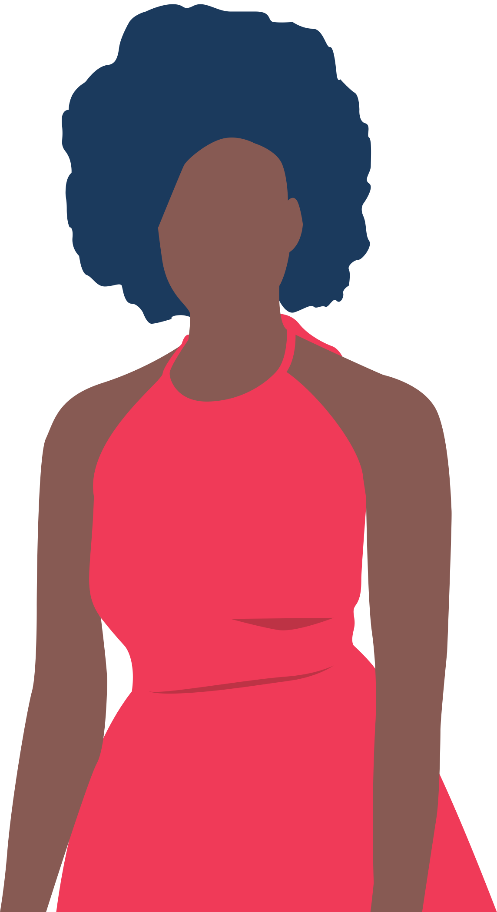
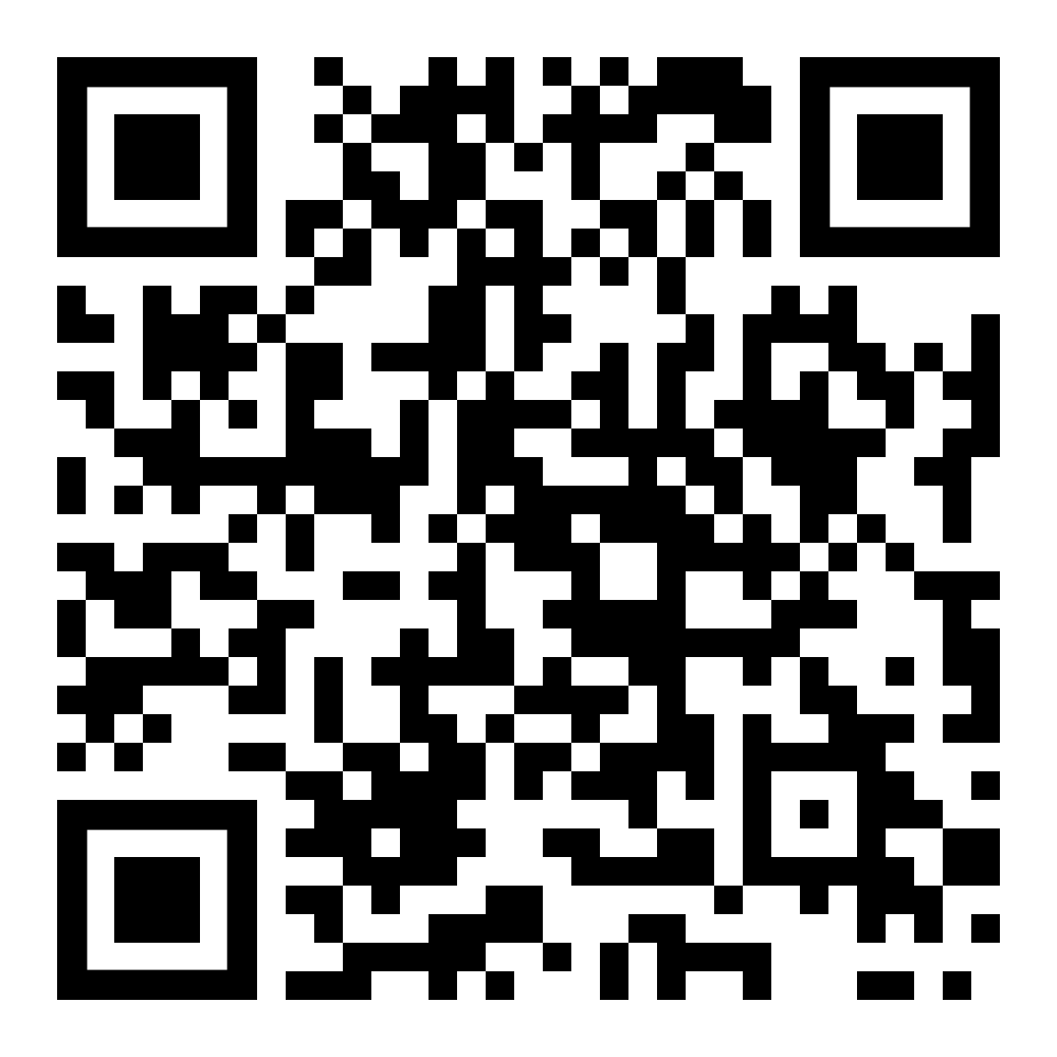
HOW DO YOU GET STARTED?
Why I think public speaking matters
How do you get started?
How do you prepare for a speech and how do you know what topics are going to be of the greatest interest to your audience?
Creating a presentation and organizing your speech
Public speaking anxiety
Additional Things To Remembers
WITH THE RIGHT SUPPORT, WOMEN CAN EXCEL IN EVERY FIELD
Notes:
How do you get started? Here I have created an article for all people in tech that would like to pursue public speaking. You will find answer to all the following question, all tipcs and tricks that I can offer you from my experience.

Slide 12
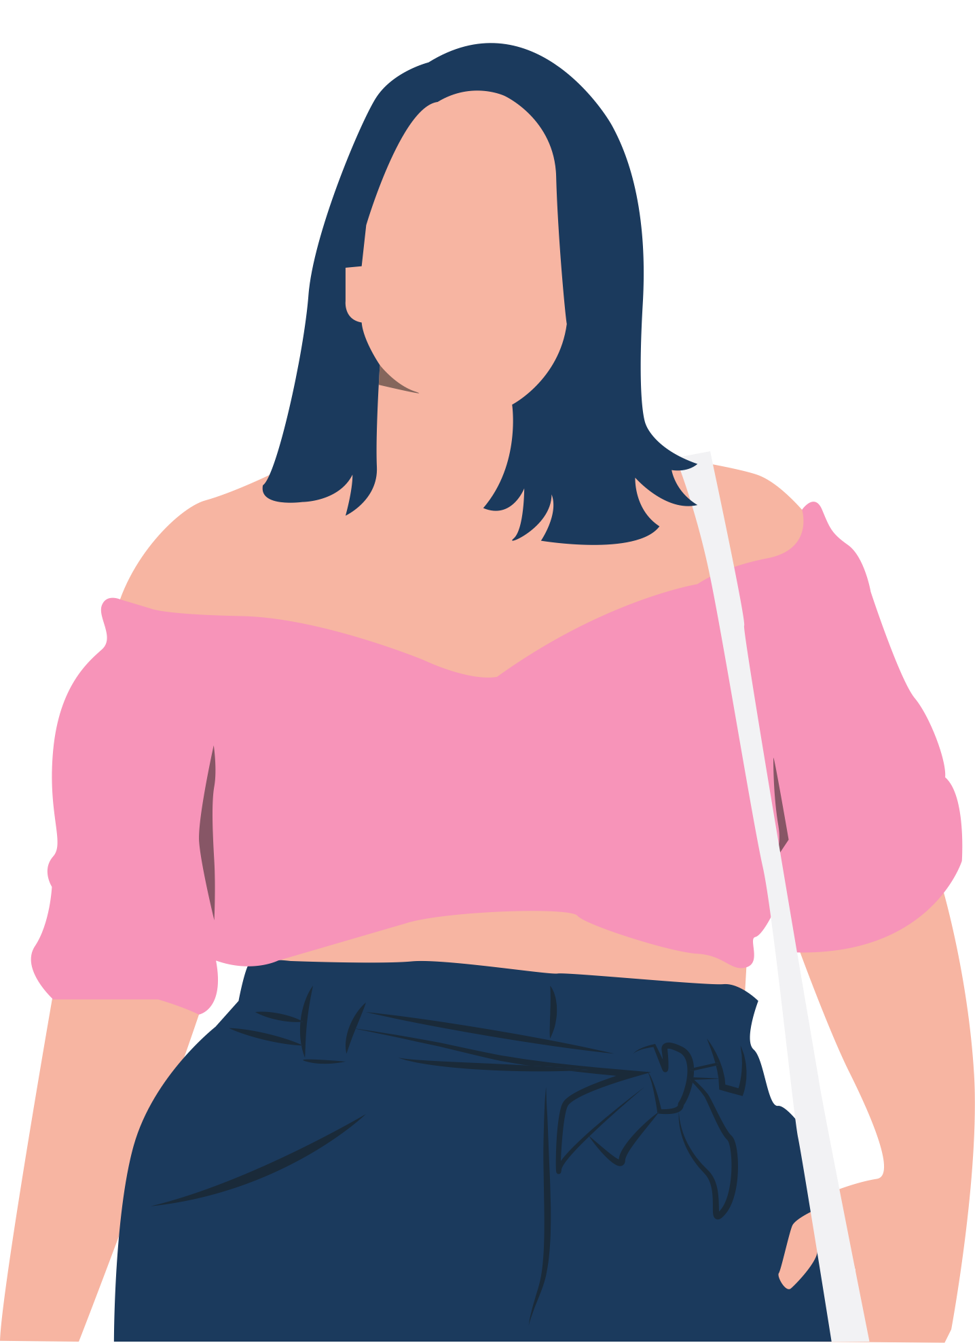
WHAT CAN BE DONE TO ENCOURAGE MORE WOMEN TO SPEAK?
Mentorship & Support: Experienced professionals can mentor and uplift women entering the field.
Active Representation: Companies and conferences must actively seek diverse speakers and leaders.
Encouraging Confidence: Women should be encouraged to share their knowledge without fear of judgment.
Notes:
Mentorship & Support Experienced professionals can play a huge role in uplifting women entering the field. Mentorship provides guidance, encouragement, and a sense of belonging. When women see role models who have navigated the same challenges, it reinforces the idea that they, too, can succeed. Companies and communities should actively foster mentorship programs to help women build confidence and gain industry insights.
Active Representation Representation matters. Companies, conferences, and event organizers must go beyond passive inclusion and actively seek diverse speakers, leaders, and role models. This means not just inviting women to speak but also ensuring they are given equal visibility and credibility as experts in their fields. Diverse representation on stage and in leadership sends a powerful message: women belong in tech at all levels.
Encouraging Confidence Many women hesitate to share their knowledge or apply for leadership roles due to self-doubt or imposter syndrome. We need to change the narrative. Women should be encouraged to submit talk proposals, share their expertise, and step into the spotlight without fear of being judged. When companies and colleagues validate women’s skills and contributions, it builds confidence and paves the way for future generations to do the same.

Slide 13
WHAT CAN ALLIES DO TO HELP?
Call Out Bias: Address dismissive or exclusionary behavior when you see it.
Amplify Women’s Voices: Recommend female colleagues for speaking opportunities and leadership roles.
Be a Support System: Offer encouragement, invite women into discussions, and validate their expertise, If you’re invited to speak, suggest a female co-speaker or panelist.
Notes:
Amplify Women’s Voices: Recommend female colleagues for speaking opportunities and leadership roles. Call Out Bias: Address dismissive or exclusionary behavior when you see it. Be a Support System: Offer encouragement, invite women into discussions, and validate their expertise.

Slide 14
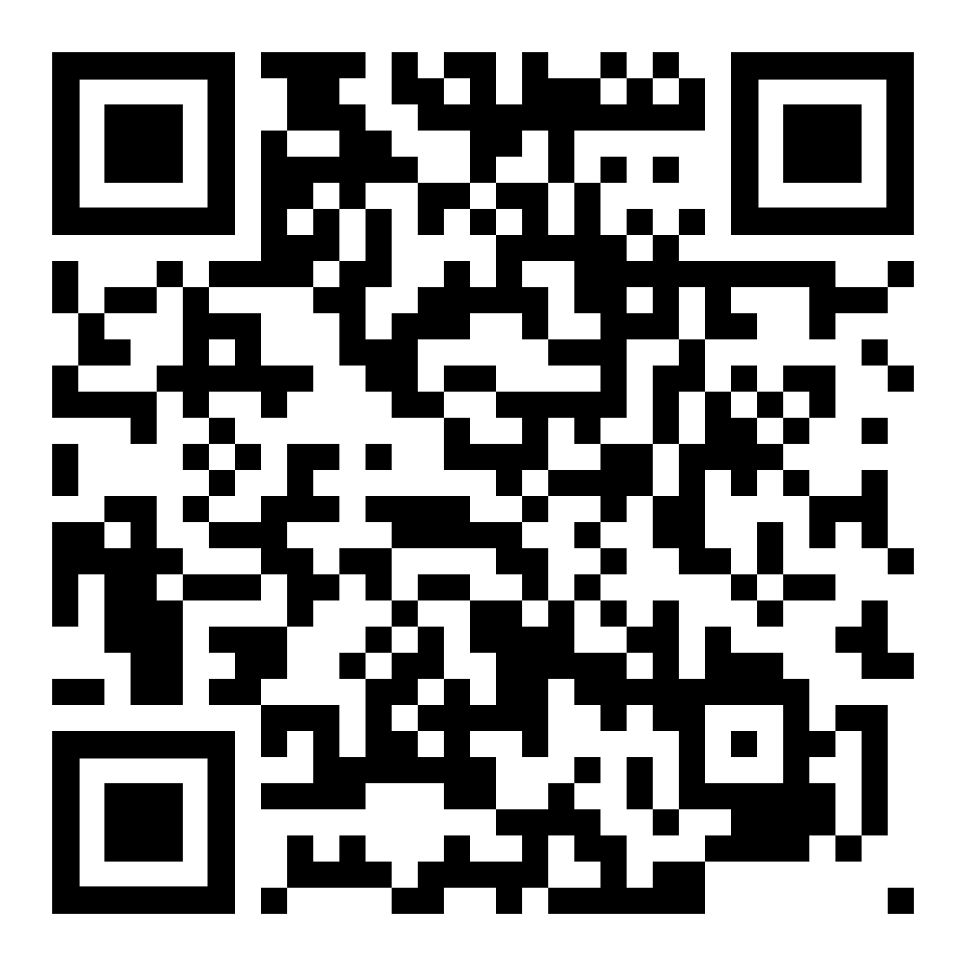
CONNECT WITH ME & ASK ME QUESTIONS

